Slide 1
Natural Language Processing Specialization Sentiment Analysis with Naïve Bayes
(2020 Deeplearning.ai)
YangXi’s Reading Notes

Slide 2
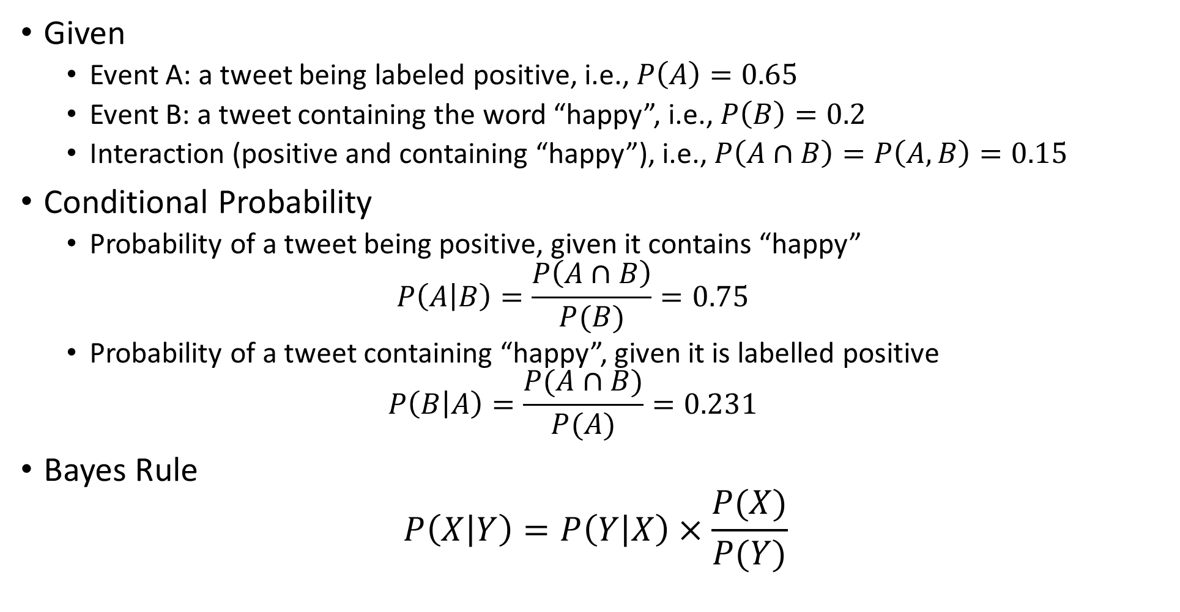
Bayes Rule
Given
Event A: a tweet being labeled positive, i.e., $P\left(A\right)=0.65$
Event B: a tweet containing the word “happy”, i.e., $P\left(B\right)=0.2$
Interaction (positive and containing “happy”), i.e., $P\left(A∩B\right)=P\left(A,B\right)=0.15$
Conditional Probability
Probability of a tweet being positive, given it contains “happy” $P\left(A | B\right)=\frac{P\left(A∩B\right)}{P(B)}=0.75$
Probability of a tweet containing “happy”, given it is labelled positive $P\left(B | A\right)=\frac{P(A∩B)}{P(A)}=0.231$
Bayes Rule $P\left(X | Y\right)=P\left(Y | X\right)×\frac{P(X)}{P(Y)}$

Slide 3
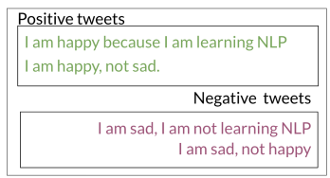
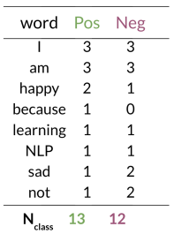
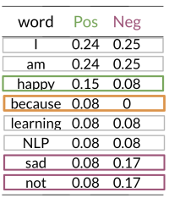
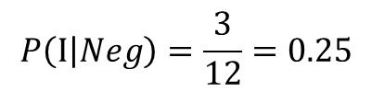
Naïve Bayes
Naïve: the assumption that all features are independent
Example
Create conditional probabilities of each word given each label
Natural words: words with equally probable don’t add anything to the sentiment
Power words: words contribute to the sentiment
0 conditional probability needs to be smoothed (Laplacian Smoothing)
$$P\left(\text{I} | Neg\right)=\frac{3}{12}=0.25$$

Slide 4
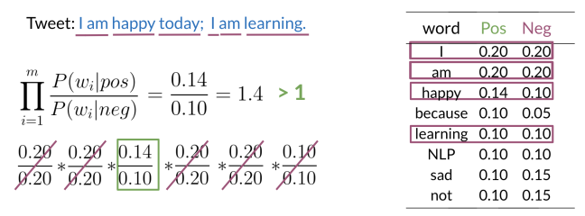

Naïve Bayes
The Naïve Bayes Inference Condition Rule for Binary Classification $\prod_{i=1}^{m}{\frac{P(w_{i}|pos)}{P(w_{i}|neg)}}$
Note that the “prior ratio” is not considered in this formulation (see later slide)

Slide 5
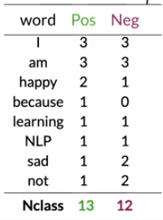
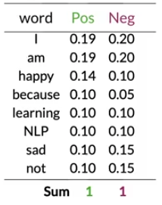
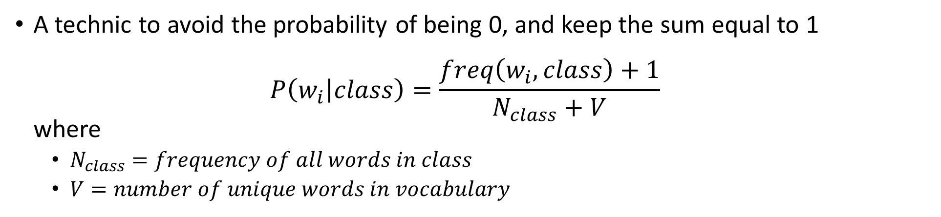
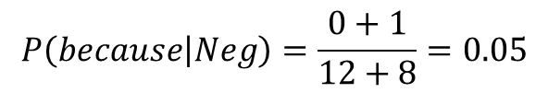
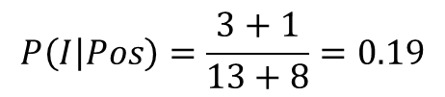
Laplacian Smoothing
A technic to avoid the probability of being 0, and keep the sum equal to 1 $P\left(w_{i} | class\right)=\frac{freq\left(w_{i},class\right)+1}{N_{class}+V}$ where
$N_{class}=frequency of all words in class$
$V=number of unique words in vocabulary$
$$P\left(I | Pos\right)=\frac{3+1}{13+8}=0.19$$
$$P\left(because | Neg\right)=\frac{0+1}{12+8}=0.05$$

Slide 6
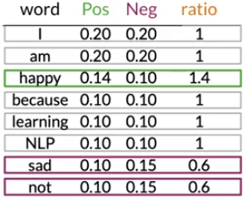
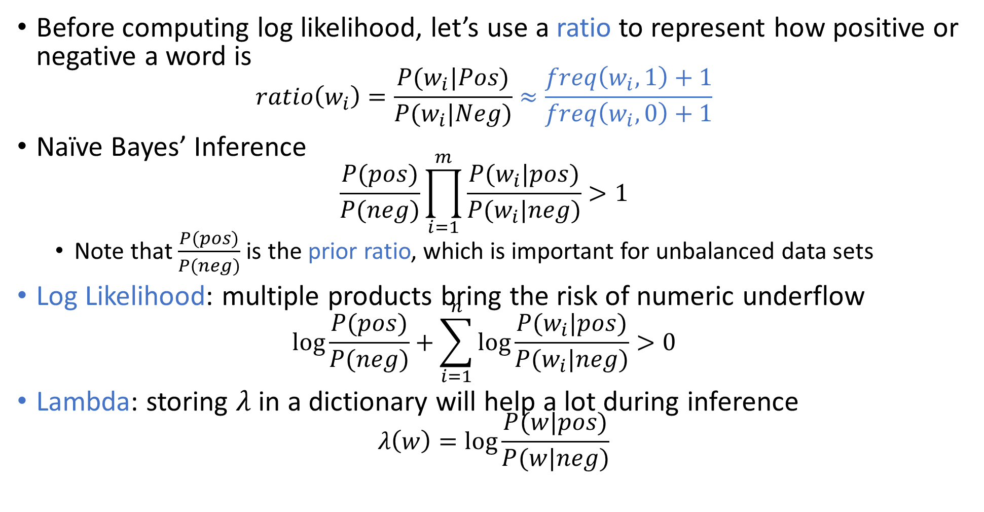
Log Likelihood
Before computing log likelihood, let’s use a ratio to represent how positive or negative a word is $ratio\left(w_{i}\right)=\frac{P(w_{i}|Pos)}{P(w_{i}|Neg)}≈\frac{freq\left(w_{i},1\right)+1}{freq\left(w_{i},0\right)+1}$
Naïve Bayes’ Inference $\frac{P(pos)}{P(neg)}\prod_{i=1}^{m}{\frac{P(w_{i}|pos)}{P(w_{i}|neg)}}>1$
Note that $\frac{P(pos)}{P(neg)}$ is the prior ratio, which is important for unbalanced data sets
Log Likelihood: multiple products bring the risk of numeric underflow $\log{\frac{P(pos)}{P(neg)}+\sum_{i=1}^{n}{\log{\frac{P(w_{i}|pos)}{P(w_{i}|neg)}}}}>0$
Lambda: storing $λ$ in a dictionary will help a lot during inference $λ\left(w\right)=\log{\frac{P(w|pos)}{P(w|neg)}}$

Slide 7
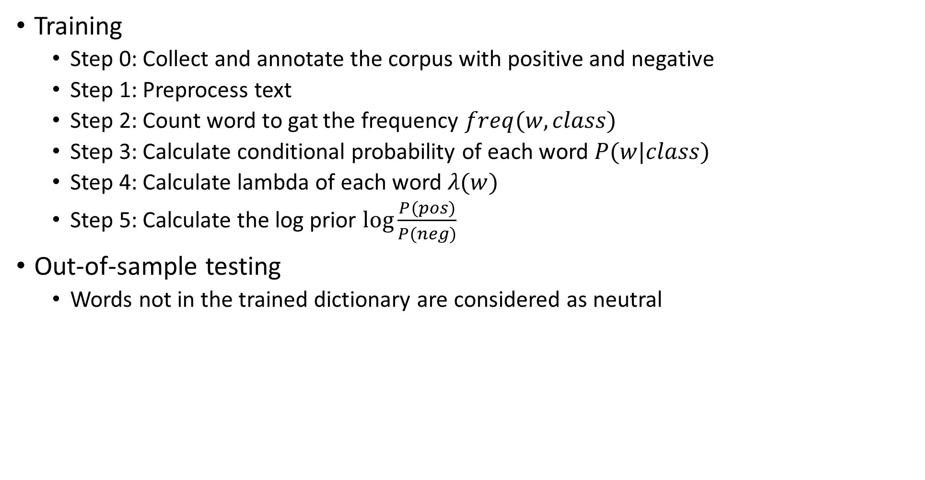
Training and Testing a Naïve Bayes Model
Training
Step 0: Collect and annotate the corpus with positive and negative
Step 1: Preprocess text
Step 2: Count word to gat the frequency $freq(w,class)$
Step 3: Calculate conditional probability of each word $P(w|class)$
Step 4: Calculate lambda of each word $λ(w)$
Step 5: Calculate the log prior $\log{\frac{P(pos)}{P(neg)}}$
Out-of-sample testing
Words not in the trained dictionary are considered as neutral

Slide 8
Naïve Bayes Assumptions
Independence between the predictors associated with each class
In reality, it is common for words in a corpus to be associated with each other
Relative frequency in corpus (validate data set)
Naïve Bayes relies on the distribution of the training data set
Most available copra are artificially balanced
Taking tweets as an example, most tweets are positive, because negative tweets often containing offensive vocabulary which are banned by the platform
As a result, a Naïve Bayes model trained on tweets trend to be overly optimistic / pessimistic

Slide 9
Error Analysis
Possible cause of errors
Semantic meaning get lost in the preprocessing step
Punctuation: “My beloved grandmother :(“
Removing words: “This is not good, because your attitude is not even close to being nice”
How word order affects meaning of a sentence
“I am happy because I did not go”
“I am not happy because I did go”
Adversarial attacks: common to human understanding but confusing to the model
Sarcasm, Irony, euphemisms
“this is a ridiculously powerful movie. The plot was gripping and I cried right through until the ending!”
This is strongly positive, but the model can suggest strongly negative.

